Slide 1
GUI-TKINTER

Slide 2
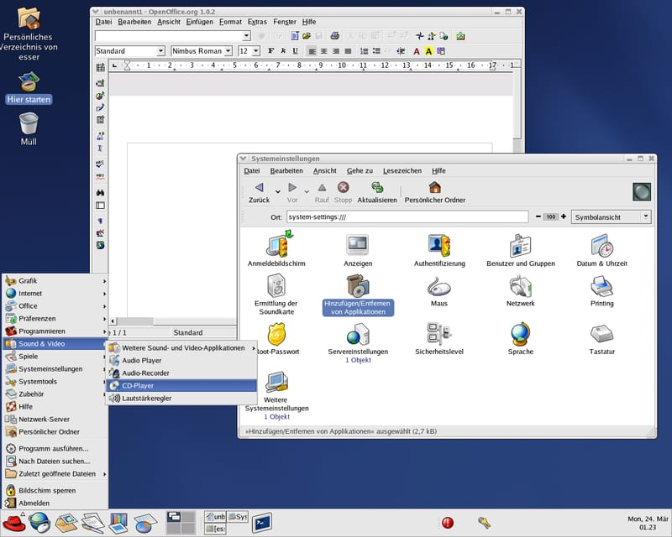
GUI:
It stands for Graphical User Interface.
It a desktop interface that allows to communicate with computers.
A GUI displays objects that convey information, and represent actions that can be taken by the user.
Example: Text Editor, Calendar, Chrome, Calculator, Games etc.,

Slide 3
GUI in python:
Python provides various options for developing graphical user interfaces(GUIs).
They are,
Tkinter
PyQt
wxPython
Jpython
Kivy
PySide
Tkinter:
Tkinter is the standard GUI library for python.
Python when combined with Tkinter provides a fast and easy way to create GUI applications.
Tkinter provides a powerful object-oriented interface to the Tk GUI toolkit.

Slide 4
Creating a GUI application using Tkinter:
Import the tkinter module.
Create the GUI application main window.
Add one or more widgets to the GUI application.
Main event loop
Creating Tk window:
import tkinter
w=tkinter.Tk()
# add widgets here
w.mainloop()
(OR)
from tkinter import *
w=Tk()
w.mainloop()

Slide 5
Example:
import tkinter
w=tkinter.Tk()
w.title("Demo")
w.geometry("500x400")
w.resizable(height="false",width="false") #or (0,0)
#w.configure(background="yellow")
w.config(bg="blue")
w.mainloop() #mainloop() is a method when your application is ready to run

Slide 6
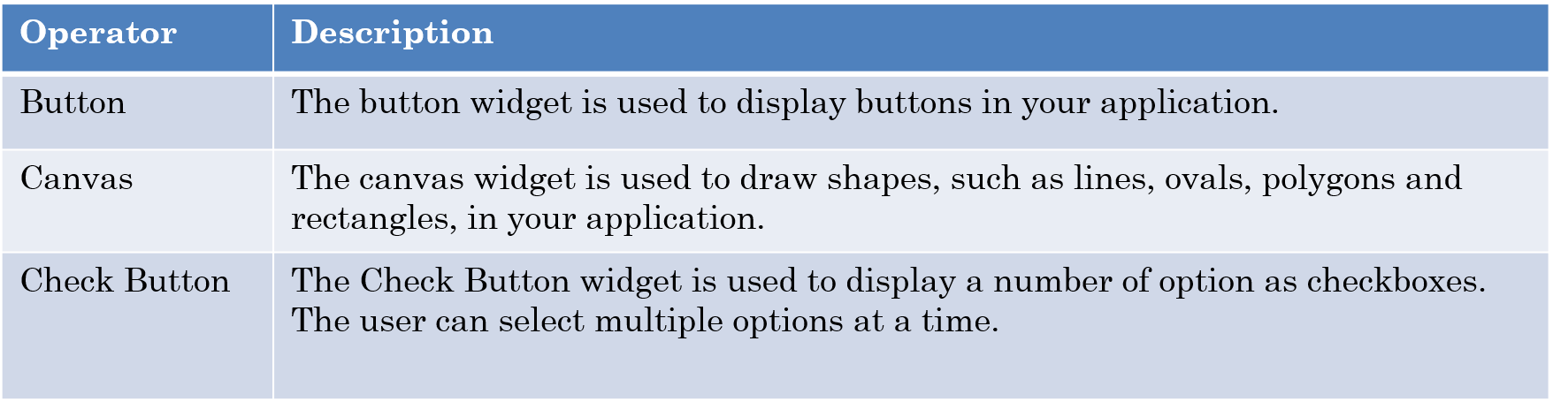
Tkinter widgets:
It provide various controls like labels and text boxes used in GUI application.
These are called widgets.
It has 15 types of widgets.

Slide 7
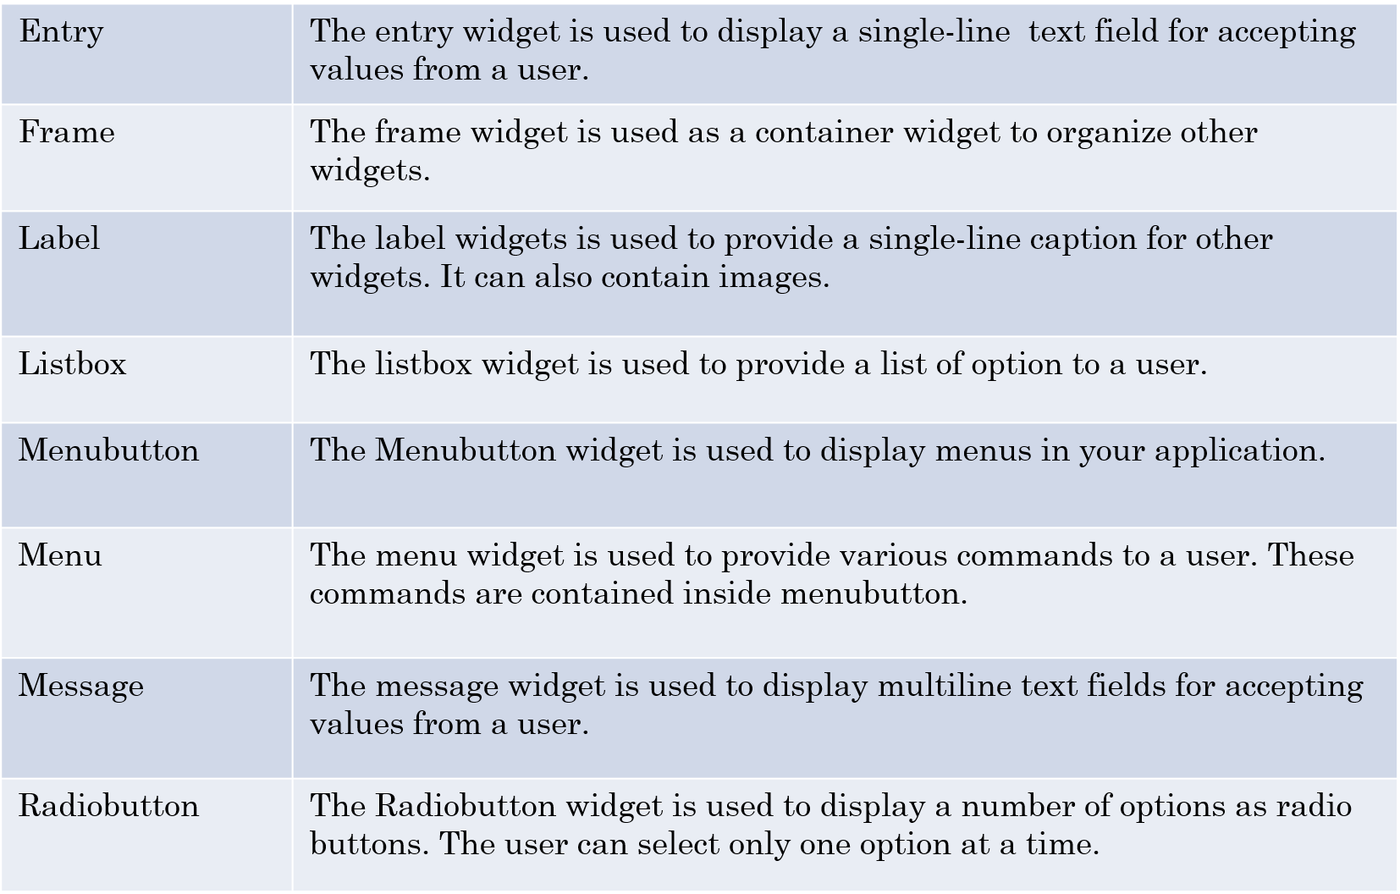

Slide 8
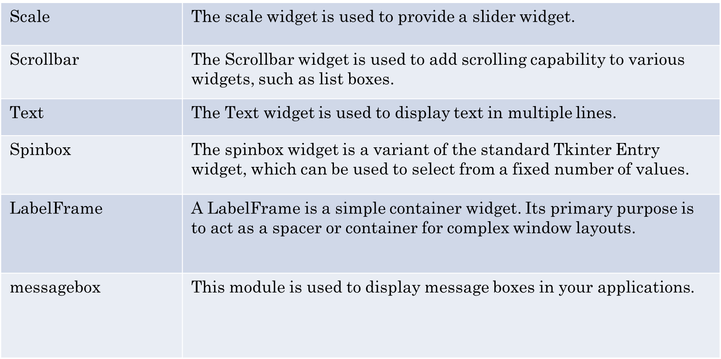

Slide 9
Geometry manager classes:
grid():
It organize the widgets in a two dimensional table (row, column).
Ex: grid(row=0, column=0)
pack():
It organize the widgets in blocks (TOP, BOTTOM, RIGHT, LEFT).
Ex: pack(side = LEFT)
place():
It organize the widgets in position (x-axis, y-axis).
Ex: place(x=50,y=10)

Slide 10
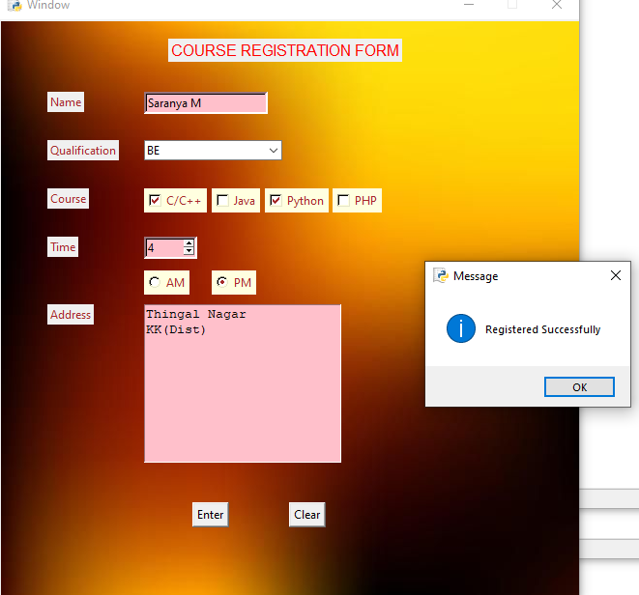
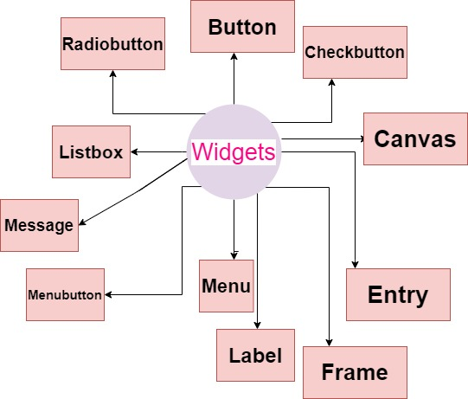

Slide 11
Button:
Syntax:
b=Button(master, option)
Option Example:
activebackground: Set the background color when button is under the cursor.
activeforeground : Set the foreground color when button is under the cursor.
bg : Set he normal background color.
command : call a function.
font : Set the font on the button label.
image : Set the image on the button.
width : Set the width of the button.
height : Set the height of the button.
padx : Additional padding to the button in the horizontal direction.
pady : Additional padding to the button in the vertical direction.
Where,
Master → parent window
Option → key,value pair separate by comma

Slide 12
Example: (Button)
from tkinter import *
w=Tk()
w.geometry("600x500")
w.title("WELCOME")
w.config(bg="pink")
def dis():
print("hello world")
b=Button(w,text="Click",font=("times",25,"bold"), bg="yellow",
fg="red", activeforeground="blue", activebackground="orange", command=dis)
b.pack()
w.mainloop()

Slide 13
Button and Message box:
from tkinter import*
from tkinter import messagebox
w=Tk()
w.geometry("600x400")
w.title("Welcome")
w.config(bg="blue")
def click():
messagebox.showinfo("message","welcome to all")
b=Button(w,text="click",font="times,20,bold",bg="grey",fg="red",command=click)
b.place(x=10,y=20)
w.mainloop()

Slide 14
Label:
A Label is a Tkinter Widget class, which is used to display text or an image.
The label is a widget that the user just views but not interact with.
Syntax:
l=Label(master, option)
Where,
Master → parent window
Option → key,value pair separate by comma
Option example:
background color, font, image, width, height, padx, pady

Slide 15
Entry:
Entry widget is used to provide the single line text-box to the user to accept a value from the user.
It accept the text strings from the user.
It can only be used for one line of text from the user.
Syntax:
e=Entry(master, option)
Where,
Master → parent window
Option → key,value pair separate by comma
Example options:
bg, height, weight, bd, cursor
bd → Set the border width in pixels
cursor → Set the cursor used ( Ex: plus cursor, circle cursor )

Slide 16
Example: (Label & Entry)
from tkinter import*
w=Tk()
w.geometry("500x500")
w.config(bg="red")
w.title("Welcome")
w.resizable(height=0,width=0)
l=Label(w, text="User Name", font=("times",20), bg="red", fg="white").place(x=50, y=50)
e=Entry(w,bd=10, cursor="plus cursor")
e.place(x=250, y=60)
w.mainloop()

Slide 17
Checkbutton:
It is used to implement on/off selections.
It used to provide many choices to the user.
It can contain text or images.
Syntax:
W=Checkbutton(master, option)
Where,
Master → parent window
Option → key,value pair separate by comma
Example options:
title, activebackground, activeforeground, bg, font

Slide 18
Example: (Checkbutton)
from tkinter import*
w=Tk()
w.geometry("500x500")
w.title("Checkbutton")
w.config(bg="yellow")
w.resizable(height=0,width=0)
l=Label(w,text="Select course", font=("times",20,"bold"), bg="red", fg="white")
l.place(x=10, y=50)
ck1=IntVar()
ck2=IntVar()

Slide 19
c1=Checkbutton(w,text="C/C++", font=("times",18),
fg="black", variable=ck1, onvalue=1, offvalue=0)
c1.place(x=80, y=100)
c2=Checkbutton(w,text="Python", font=("times",18),
fg="black", variable=ck2, onvalue=1, offvalue=0)
c2.place(x=200, y=100)
w.mainloop()

Slide 20
Radiobutton:
This widget implements a multiple-choice button.
It offer many possible selections and lets user choose only one of them.
Syntax:
W=Radiobutton (master, option)
Where,
Master → parent window
Option → key,value pair separate by comma
Example options:
activebackground, activeforeground, background, font, width, height

Slide 21
Example: (Radiobutton)
from tkinter import *
w=Tk()
w.geometry("400x400")
w.title("Radiobutton")
l=Label(w, text="Gender", font=("times",20,"bold"), bg="blue", fg="yellow")
l.place(x=10,y=50)
rd=IntVar()
m=Radiobutton(w, text="Male", value=1, variable=rd)
f=Radiobutton(w, text="Female", value=2, variable=rd)
o=Radiobutton(w, text="Others", value=3, variable=rd, state="disable")
m.place(x=100, y=100)
f.place(x=200, y=100)
o.place(x=300, y=100)
w.mainloop()

Slide 22
Listbox:
This widget is used to display a list of items.
The user can select one or more items from the given list.
Syntax:
W=Listbox (master, option)
Where,
Master → parent window
Option → key,value pair separate by comma
Option example:
bg, fg, font, height, weight, cursor, highlightcolor, yscrollcommand, xscrollcommand
highlightcolor → colour of the list items when focused
yscrollcommand → scrolling vertically
xscrollcommand → scrolling horizontally

Slide 23
Example: (Listbox)
from tkinter import*
w=Tk()
w.geometry("400x400")
w.configure(bg="brown")
w.title("Listbox")
l=Label(w, text="Fruits List", font=("times",20,"bold"), bg="blue")
l.place(x=50,y=50)
li=Listbox(w, bd=8)
li.insert(1,"Apple")
li.insert(2,"Orange")
li.insert(3,"Mango")
li.place(x=100, y=100)
w.mainloop()

Slide 24
Combobox:
It is a combination of Listbox and an entry field.
It contains a down arrow to select from a list of options.
Syntax:
W=Combobox (master, option)
Where,
Master → parent window
Option → key,value pair separate by comma

Slide 25
Example: (Combobox)
from tkinter import*
from tkinter.ttk import Combobox
w=Tk()
w.geometry("400x400")
w.title("Combobox")
l=Label(w, text="Combobox", font=("times",18,"bold"))
l.place(x=10,y=50)
cb=Combobox(w, width=14, font=("times", 12))
cb['values'] = ('Nagercoil', 'Marthandam', 'Chennai', 'Madurai')
cb.current(0)
cb.place(x=150,y=60)
w.mainloop()

Slide 26
Menubutton:
A menubutton is the part of a drop-down menu that stays on the screen all the time.
Every menubutton is associated with a Menu widget that can display the choices for that menubutton when the user clicks on it.
Syntax:
W=Menubutton (master, option)
Where,
Master → parent window
Option → key,value pair separate by comma
Option example:
bg, activebackground, active foreground, bd, cursor, width, height, highlightcolor

Slide 27
Example:
from tkinter import*
w=Tk()
w.geometry("400x400")
w.title("Menubutton")
mb=Menubutton(w, text="Languages", relief=RAISED)
mb.m=Menu(mb,tearoff=1)
mb['menu']=mb.m
v1=IntVar()
v2=IntVar()
mb.m.add_checkbutton(label="Tamil", variable=v1)
mb.m.add_checkbutton(label="English", variable=v2)
mb.pack(side=TOP)
w.mainloop()

Slide 28
Menu:
It is used to create various types of menus (top level, pull down, and pop up) in the python application.
Syntax:
W=Menu (master, option)
Where,
Master → parent window
Option → key,value pair separate by comma
Options example:
Activebackground, activeforeground, bg, title, command, font, image

Slide 29
Example:
from tkinter import*
w=Tk()
w.geometry("400x400")
w.title("Menu")
w.config(bg="blue")
menubar=Menu(w)
file=Menu(menubar, tearoff=0)
file.add_command(label="New")
file.add_command(label="Open")
file.add_command(label="Save")
file.add_command(label="Save as..")
file.add_command(label="Close")
file.add_separator()
file.add_command(label="Exit")
menubar.add_cascade(label="File", menu=file)

Slide 30
edit=Menu(menubar, tearoff=0)
edit.add_command(label="Undo")
edit.add_separator()
edit.add_command(label="Cut")
edit.add_command(label="Copy")
edit.add_command(label="Paste")
edit.add_command(label="Delete")
edit.add_command(label="Select All")
menubar.add_cascade(label="Edit", menu=edit)
help=Menu(menubar, tearoff=0)
help.add_command(label="About")
menubar.add_cascade(label="Help", menu=help)
w.config(menu=menubar)
w.mainloop()

Slide 31
Scale:
The Scale widget provides a graphical slider object that allows to select values from a specific scale.
Syntax:
W=Scale (master, option)
Where,
Master → parent window
Option → key,value pair separate by comma
Option example:
cursor, activebackground, bg, width, from, to ,orient
from → To set the value of one end of the scale range
to → To set the value of the other end of the scale range
orient → Set it to HORIZONTAL or VERTICAL according to the requirement

Slide 32
Example:
from tkinter import*
w=Tk()
w.geometry("400x400")
w.title("Scale")
w.config(bg="lightblue")
v=DoubleVar()
s=Scale(w, from_=1, to =100, variable=v, orient=HORIZONTAL)
s.pack(anchor=CENTER)

Slide 33
def select():
result='value='+str(v.get())
l1.config(text=result)
b=Button(w, text="value", command=select)
b.pack(anchor=CENTER, pady=40)
l1=Label(w, text="measurment")
l1.pack()
w.mainloop()

Slide 34
Scrollbar:
It provides a slide controller that is used to implement vertical scrolled widgets, such as Listbox, Text and Canvas.
Note that you can also create horizontal scrollbars on Entry widgets.
Syntax:
W=Scrollbar (master, option)
Where,
Master → parent window
Option → key,value pair separate by comma
Option example:
width, activebackground, bg, bd, cursor

Slide 35
Example:
from tkinter import*
w=Tk()
w.geometry("400x400")
w.title("Scrollbar")
scrollbar=Scrollbar(w)
scrollbar.pack(side=RIGHT, fill=Y)
mylist=Listbox(w, yscrollcommand=scrollbar.set)
for line in range(100):
mylist.insert(END, "This is line number" +str(line))
mylist.pack(side=LEFT, fill=BOTH)
scrollbar.config(command=mylist.yview)
w.mainloop()

Slide 36
Text:
The Text widget is used to show the text data on the Python application.
Syntax:
W=Text (master, option)
Where,
Master → parent window
Option → key,value pair separate by comma
Option example:
highlightcolor, bg, font, width, height

Slide 37
Example: (scroll and text)
from tkinter import*
w=Tk()
w.geometry("500x400")
w.title("Text")
y=Scrollbar(w, orient=VERTICAL)
y.pack(side=RIGHT, fill =Y)
x=Scrollbar(w, orient=HORIZONTAL)
x.pack(side=BOTTOM, fill=X)
t=Text(w, height=500, width=500, yscrollcommand=y.set,
xscrollcommand=x.set, wrap='none')
for i in range(50):
t.insert(END, '\n Graphical User Interface Tkinter python programming')
y.config(command=t.yview)
x.config(command=t.xview)
t.pack()
w.mainloop()

Slide 38
Spinbox:
It is a variant of the standard Tkinter Entry widget, which can be used to select from a fixed number of values.
Syntax:
W=Spinbox (master, option)
Where,
Master → parent window
Option → key,value pair separate by comma
Options example:
bg, bd, cursor, width, activebackground, disabledbackground, from_, to

Slide 39
Example:
from tkinter import*
w=Tk()
w.geometry("400x400")
w.title("Spinbox")
spin=Spinbox(w, from_=0, to=25, font=20)
spin.pack()
w.mainloop()

Slide 40
Message:
The Message widget is used to show the message to the user regarding the behavior of the python application.
The message text contains more than one line.
It provides a multiline and non editable object that displays texts, automatically breaking lines and justifying their contents.
Syntax:
W=Message (master, option)
Where,
Master → parent window
Option → key,value pair separate by comma
Option example:
bd, bg, font, width, height, relief, padx, pady

Slide 41
Example:
from tkinter import*
w=Tk()
w.geometry("400x400")
w.title("Message")
v=StringVar()
m=Message(w, textvariable=v, relief=RAISED, padx=50, pady=50)
v.set("Hey! Good Morning")
m.pack()
w.mainloop()

Slide 42
Canvas:
It is used to draw pictures and other complex layout like graphics, text and widgets.
Syntax:
W=Canvas (master, option)
Where,
Master → parent window
Option → key,value pair separate by comma
Option example:
bd, bg, cursor, highlightcolor, width, height

Slide 43
Example:
from tkinter import*
w=Tk()
w.geometry("700x400")
c=Canvas(w, bg="blue", height=350, width=600)
coord=(80, 60, 240, 240)
arc=c.create_arc(coord, start=0,extent=350, fill="red")
c.pack()
w.mainloop()

Slide 44
Frame:
It is used to organize the group of widgets.
It acts like a container which can be used to hold the other widgets.
The rectangular areas of the screen are used to organize the widgets.
Syntax:
W=Frame (master, option)
Where,
Master → parent window
Option → key,value pair separate by comma
Option example:
highlightcolor, bd, bg, cursor, width, height

Slide 45
Example:
from tkinter import*
w=Tk()
w.geometry("400x400")
w.title("Frame")
frame=Frame(w)
frame.pack()
bottomframe=Frame(w)
bottomframe.pack(side=BOTTOM)
redbutton=Button(frame, text="Red", fg="red")
redbutton.pack(side=LEFT)
greenbutton=Button(frame, text='Brown', fg="brown")
greenbutton.pack(side=LEFT)
bluebutton=Button(frame, text='Blue', fg='blue')
bluebutton.pack(side=LEFT)
blackbutton=Button(frame, text='Black', fg='black')
blackbutton.pack(side=BOTTOM)
w.mainloop()

Slide 46
Toplevel:
It is used to create a window on top of all other windows.
It is directly controlled by the window manager.
It don’t need any parent window to work on.
Syntax:
W=Toplevel (option)
Where,
Option → key,value pair separate by comma
Option example:
bd, bg, cursor, width, height

Slide 47
Example:
from tkinter import*
w=Tk()
w.geometry("600x600")
w.title("Toplevel")
t=Toplevel()
t.title("Python")
w.mainloop()

Slide 48
Example:
from tkinter import*
w=Tk()
def qus1():
w.withdraw()
global t
t=Toplevel()
t.config(bg="pink")
t.geometry('600x600')
l=Label(t, text='1. What is the orange part of theegg is called ?',
bg='pink', font=('link free', 14))
l.place(x=20,y=10)

Slide 49
global r
r=StringVar()
r1=Radiobutton(t, text='York', font=('times', 14), bg='pink', value='York',
variable=r, tristatevalue=0).place(x=55,y=45)
r2=Radiobutton(t, text='Yolk', font=('times', 14), bg='pink', value='Yolk',
variable=r, tristatevalue=0).place(x=130, y=45)
r3=Radiobutton(t, text='Woke', font=('times', 14), bg='pink', value='Woke',
variable=r, tristatevalue=0).place(x=210, y=45)
r3nxtbutn=Button(t, text='Next', padx=11, pady=11, bg='yellow',
font=('times', 14), command=qus2).place(x=450, y=500)

Slide 50
def qus2():
t.withdraw()
global t1
t1=Toplevel()
t1.config(bg="blue")
t1.geometry('600x600')
t1=Label(t1, text='Hello welcome to all', bg='blue', font=('times',14))
t1.place(x=20, y=10)
w.geometry('600x600')
w.config(bg='green')
b=Button(w, text='start', font=('times', 14), command=qus1).place(x=100, y=100)
w.mainloop()

Slide 51
Image:

